Slide 1

HEART FAILURE PREDICTION
Under the Guidence of:
Dr.S.V.N.Sreenivasu, M.Tech, Ph.D
Professor.
Team Members:
T.Hemalatha (17471A05D5)
G.Mounika (17471A05H1)
K.Prasanthi (17471A05E0)
G.Hema vani (17471A05I0)

Slide 2
ABSTRACT:
Heart failures are the number 1 cause of death globally, taking an estimated 17.9 million lives each year. CVDs are a group of disorders of the heart and blood vessels and include coronary heart disease, cerebrovascular disease, rheumatic heart disease and other conditions. Four out of 5CVD deaths are due to heart attacks and strokes, and one third of these deaths occur prematurely in people under 70 years of age. Most cardiovascular diseases can be prevented by addressing behavioural risk factors such as tobacco use, unhealthy diet and obesity, physical inactivity and harmful use of alcohol using population-wide strategies.Individuals at risk of CVD may demonstrate raised blood pressure, glucose, and lipids as well as overweight and obesity. These can all be easily measured in primary care facilities. Identifying those at highest risk of CVDs and ensuring they receive appropriate treatment can prevent premature deaths.Access to essential noncommunicable disease medicines and basic health technologies in all primary health care facilities is essential to ensure that those in need receive treatment and counselling.

Slide 3
INTRODUCTION:
Heart failure is a term covering any disorder of the heart. Heart failure have become a major concern to deal with as studies show that the number of deaths due to heart failure have increased significantly over the past few decades in India, in fact it has become the leading cause of death in India.
A study shows that from 1990 to 2016 the death rate due to heart failures have increased around 34 per cent from 155.7 to 209.1 deaths per one lakh population in India.
Thus preventing Heart failures has become more than necessary. Good data-driven systems for predicting heart failures can improve the entire research and prevention process, making sure that more people can live healthy lives. This is where Machine Learning comes into play. Machine Learning helps in predicting the Heart failures, and the predictions made are quite accurate.

Slide 4
Classification algorithms are very important category of supervised machine learning algorithms. These algorithms require a very large training set. These training data sets are consisting of many features or attributes which describe the individual sample. Since we are doing supervised learning algorithm. All the training set are labelled correctly. The classification algorithms such as decision trees, Gaussian Naïve Bayes, Random Forest, K-nearest Neighbours, K-Means and support vector machines (SVM), develop model with these data with many different parameters. When we have a new unlabelled sample.

Slide 5
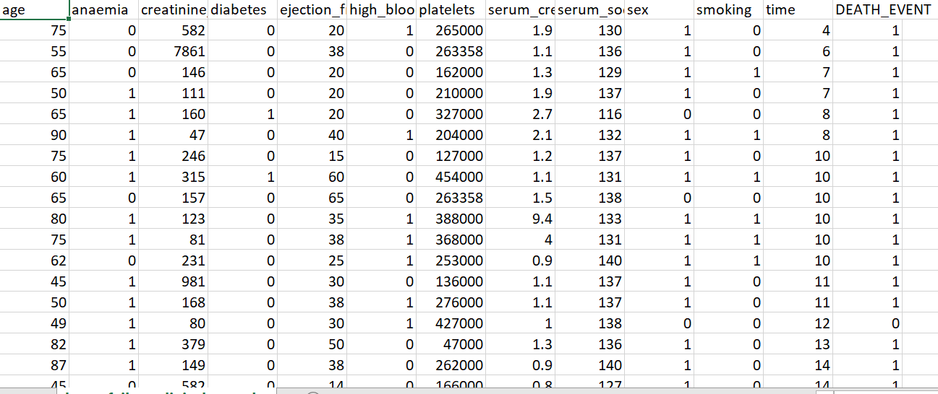
DATASET:

Slide 6
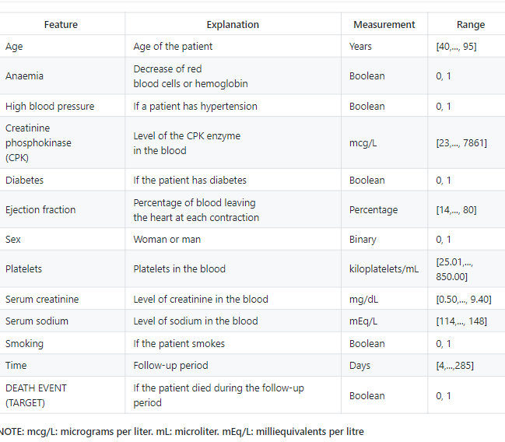
DATASET DESCRIPTION:

Slide 7
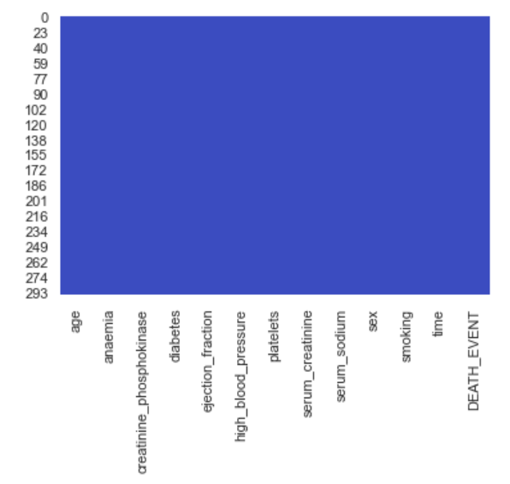
DATA PRE-PROCESSING:
Before feeding data to an algorithm we have to apply transformations to our data which is referred as pre-processing. By performing pre-processing the raw data which is not feasible for analysis is converted into clean data. In-order to achieve better results using a model in Machine Learning, data format has to be in a proper manner. The data should be in a particular format for different algorithms. For example, if we consider Random Forest algorithm it does not support null values. So that those null values have to be managed using raw data.
MISSING VALUES:
Missing data visualization without NULL values

Slide 8
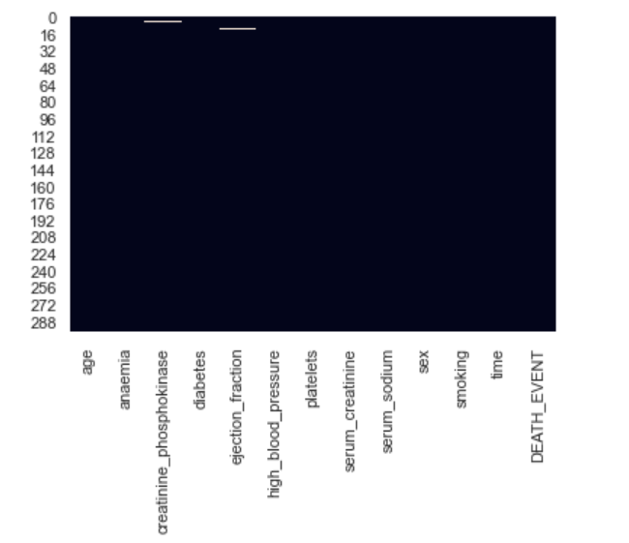
Missing data visualization with NULL values:

Slide 9
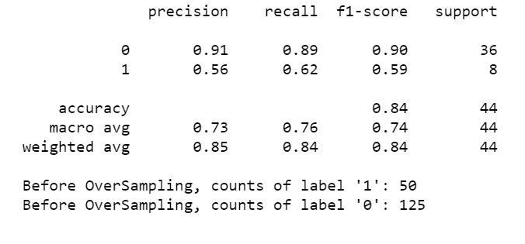
SMOTE:
SMOTE (Synthetic minority oversampling technique) is one of the most commonly used oversampling methods to solve the imbalance problem. It aims to balance class distribution by randomly increasing minority class examples by replacing them. Smote synthesizes new minority instances between existing minority instances. It generates the virtual training records by linear interpolation for the minority class. Fig 1 shows class distribution before smote technique, fig 2 shows class distribution after smote technique. After applying smote the class distribution has equal count of both bad and good.
Fig1. Class distribution Before SMOTE technique

Slide 10
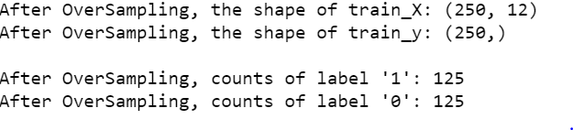
Fig 2 .Class distribution After SMOTE technique

Slide 11
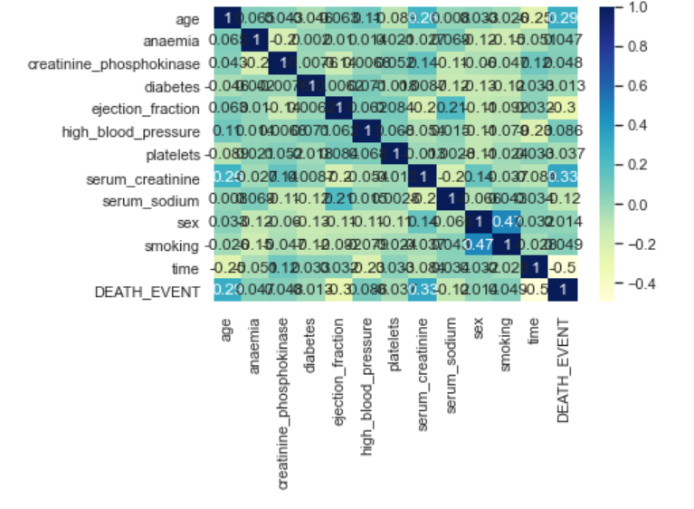
Feature Selection
It is process of reducing the number of input attributes or variables when developing a model in order to reduce the computation cost of model and in some cases to increase or improve the performance or accuracy of the model.
Correlation
Fig. Correlation for Heart Failure Dataset

Slide 12
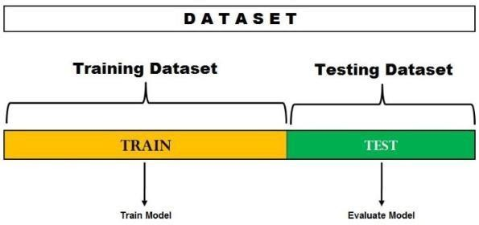
CLASSIFICATION TECHNIQUES:
Classification is a data mining function that assigns items in a collection to target categories or classes. Classification is a supervised learning and can be performed on both structured and unstructured data. The goal of classification is to accurately predict the target class for each case in the data. Classes are called as targets or labels or categories. Classification predictive modelling is task of mapping function (f) from input variables (X) to discrete output variables (y). There are many classification algorithms available in machine learning.
  Holdout cross-validation:
  Fig. Holdout cross-validation

Slide 13
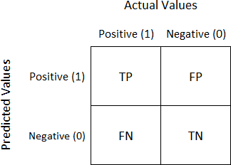
  Performance Evaluation:
A confusion matrix is a table that is often used to describe the performance of a classification model(or “classifier”) on a set of test data for which true values are known.
Fig.Confusion matrix

Slide 14
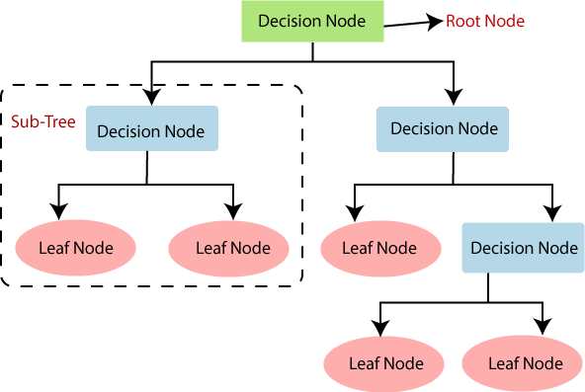
CLASSIFICATION:
Classification is a technique which is used to classify data into some definite number of classes. The main goal of classification is to accurately predict the target class for each case in the data.
-Classification Algorithms in Machine Learning:
1. Decision tree classifier:Decision trees are constructed via an algorithmic approach that identifies ways to split a data set based on different conditions. It is one of the most widely used and practical methods for supervised learning.

Slide 15
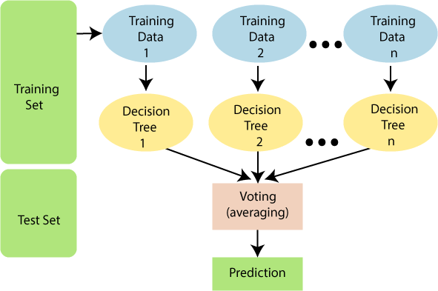
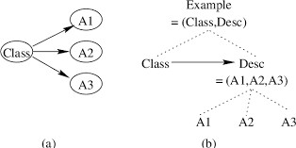
2. Random Forest Classifier:Random Forest Classifier are an ensemble learning method for classification and regression techniques. It builds multiple decision trees and then merges them together in-order to get more accurate and stable predictions.
3.Naïve bayes:Naïve Bayes is a classification algorithm that relies on strong assumptions of the independence of covariates in applying Bayes Theorem. Bayes theorem is P(C|X) = P(X|C) * P(C)/P(X), where X is the data tuple and C is the class such that P(X) is constant for all classes.

Slide 16
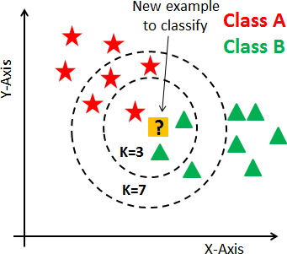
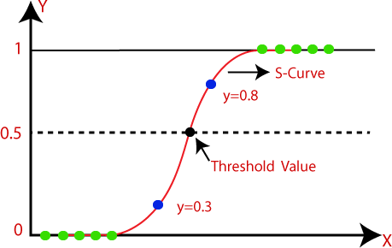
4. K-Nearest Neighbours:K-Nearest Neighbour is a supervised learning algorithm that can be used for regression as well as classification problems. KNN algorithms decide a number k which is the nearest Neighbour to that data point which is to be classified.
5. Logistic Regression:Logistic regression is a process of modeling the probability of a discrete outcome given an input variable. The most common logistic regression models a binary outcome; something that can take two values such as true/false, yes/no, and so on.

Slide 17
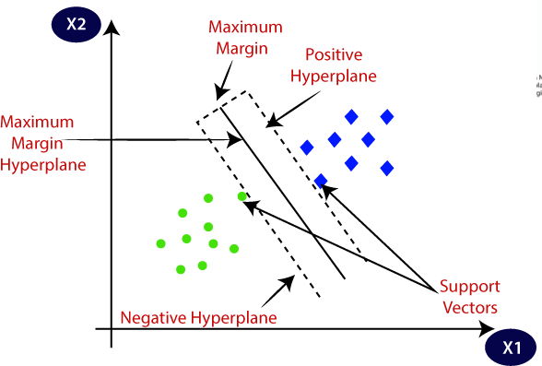
6.Support Vector Machine:
SVM is a supervised training algorithm that can be useful for the purpose of classification and regression. SVM can be used to analyse data for classification and regression using algorithms and kernels in SVM. Support vector classification also is an algorithm that searches for the optimal separating surface. SVC is outlined first for the linearly separable case. SVM kernel methods are used when complete separations of the two classes are not possible. Some widely used kernels in SVM are polynomial, quadratic, and radial basis function.

Slide 18
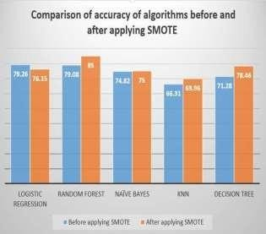
RESULT ANALYSIS:
Fig. Comparison of accuracy before and after applying SMOTE

Slide 19
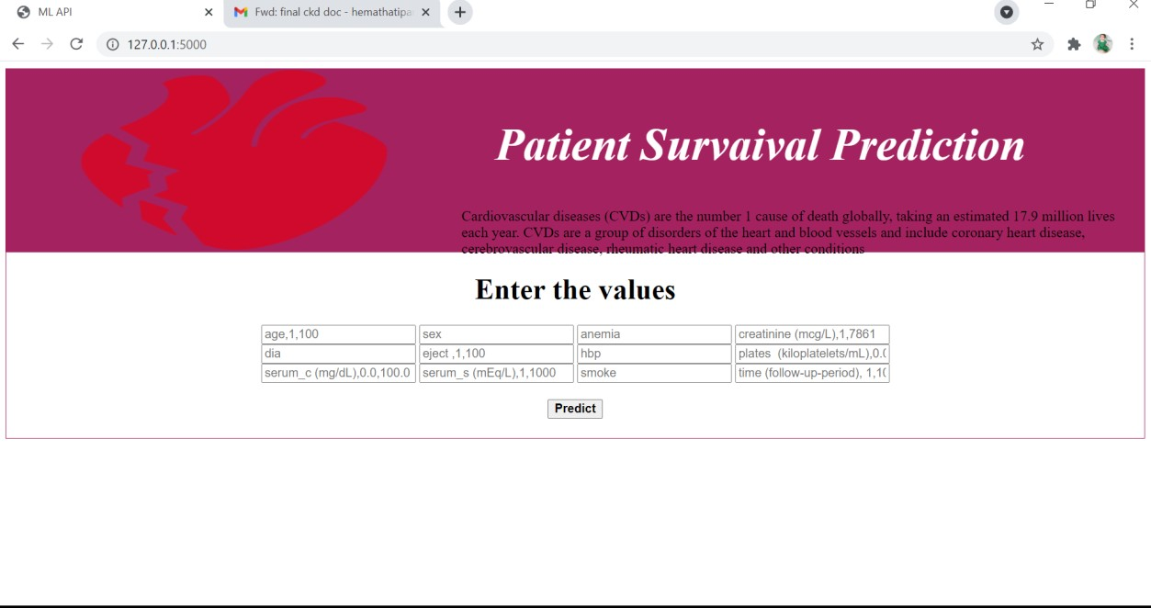
OUTPUT SCREENS
Fig.Main page

Slide 20
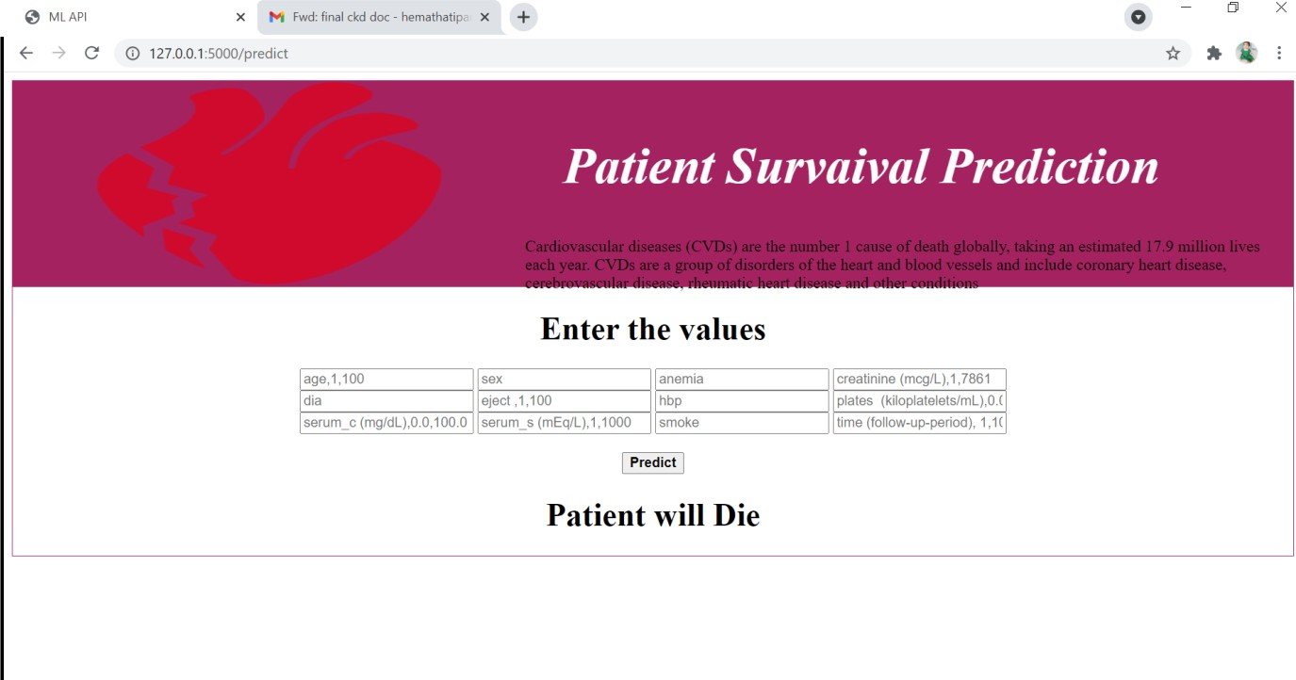
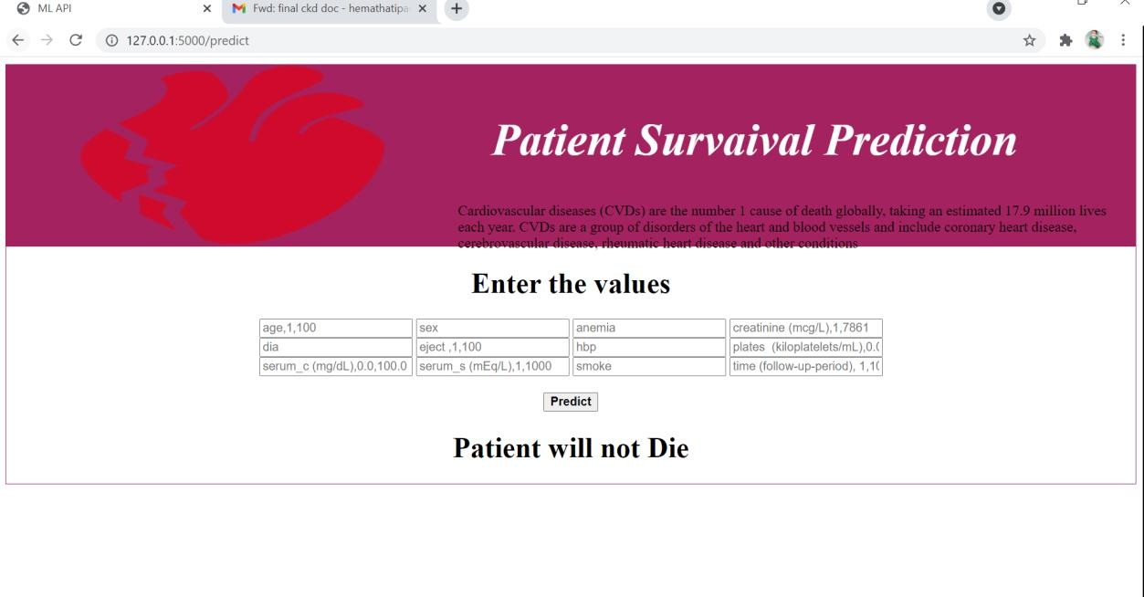
Prediction Yes:
Prediction No:

Slide 21
CONCLUSION:
We have used 6 algorithms like Decision Trees, Random Forests, Naive Bayes, SVM, KNN and Logistic Regression in-order to predict presence or absence of heart failure. The accuracy varies for different algorithms. The accuracy for Decision tree algorithm is 93.33%. The accuracy for Random Forest algorithm is 96.19%. The accuracy for Naive Bayes algorithm is 93.80%. The accuracy for KNN algorithm is 93.80%. The accuracy for Logistic Regression algorithm is 94.28%. The accuracy for SVM algorithm is 93.80%. The highest accuracy is given when we have used Random Forest algorithm is nearly 100.00%.

Slide 22
FUTURE SCOPE:
This project further can be developed as Android app and also suggest precautions to be taken by the person.

Slide 23


